Slide 1
Evolution of Gregorian Chant
Howard Liu, Michelle Lu

Slide 2
Contents
Introduction to Gregorian Chant
Collecting Data
Goal
Statistical Methods
Results
Conclusion

Slide 3
Introduction to Gregorian Chant
Developed between 9th and 10th century in western and central Europe
Sacred song of the Roman Catholic church sang by men and boys in choir
Passed orally to other parts of Europe
Went through a series of revisions
Later on, put to paper to make it easier to pass on
Written in neume notation

Slide 4
Gregorian Chant Continued
Let’s listen to what a Gregorian Chant sounds like!
https://www.youtube.com/watch?v=2jDKa67CbKE
(Benedicite Dominum)

Slide 5
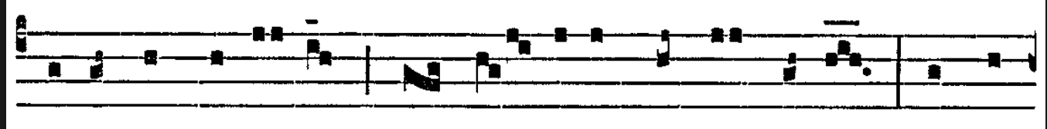
Collecting Data
Excerpt from Benedicite Dominum:
Transcribing process: (# of half steps away from center C)
The first measure would be translated as -5, -5, -3, -3, -3, 0, 0 , -1, -3.
Aligned similar phrases with each other

Slide 6
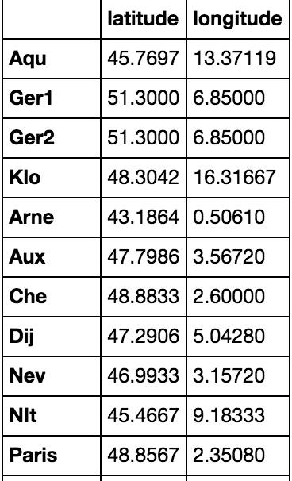
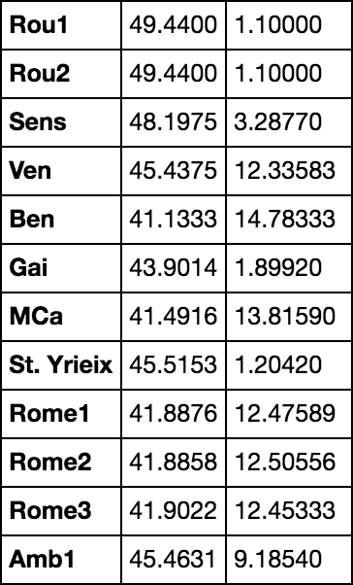
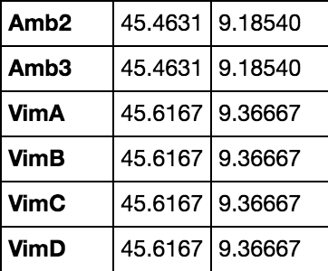
Collecting Data continued...

Slide 7
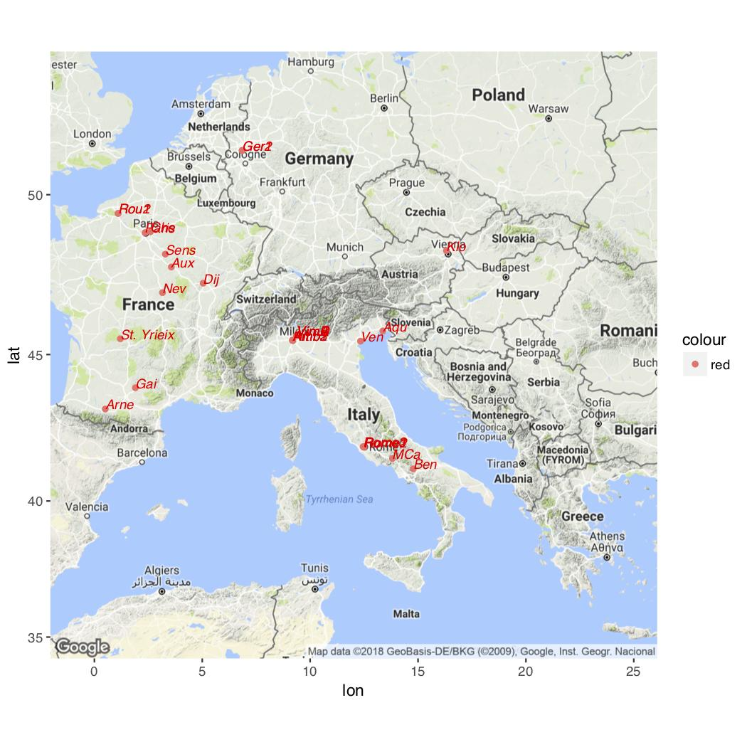
Goal

Slide 8
Statistical Methods
We utilized various different distance metrics
Approximate String Distance (aka edit distance)
(1,2,3) -> (1,2,3,4) => distance of 1 (only one insertion of ‘4’ needed)
Manhattan Distance
sum( |p_{i} - q_{i}| ) => (1,2,3,4) -> (2,3,4,5) => 1 + 1 + 1 + 1 = 4
Canberra Distance
sum( |p_{i} - q_{i}| ) / ( |p_{i}| + |q_{i}| ) => (1,2,3,4) -> (2,3,4,5,) => ⅓ + ⅕ + 1/7 + 1/9 = 0.787
Euclidean Distance
(1,2,3,4) -> (2,3,4,5) => (1-2)² + (2-3)² + (3-4)² + (4-5)² = 4
MSE Distance
(1,2,3) -> (2,3,4) =>( ⅓)[(1-2)² + (2-3)² + (3-4)²] = 1

Slide 9
Multidimensional Scaling (MDS)
Allows you to visualize the level of similarity of individual cases
A form of non-linear dimensionality reduction
Plots distances in N-dimensional space (in our case N=2)
Takes the different distances and plots them on a 2D plane
Goal: Given pairwise dissimilarities, construct a map that preserves distances

Slide 10
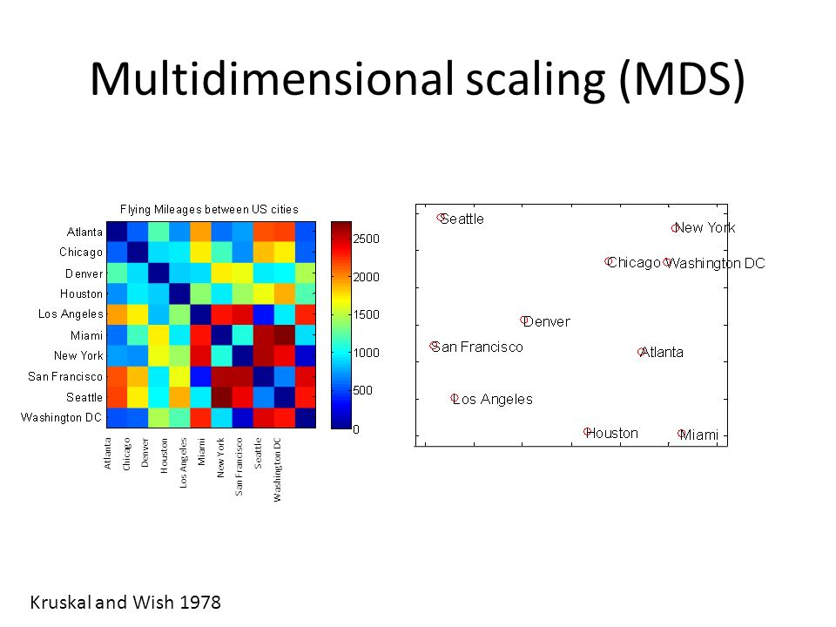

Slide 11
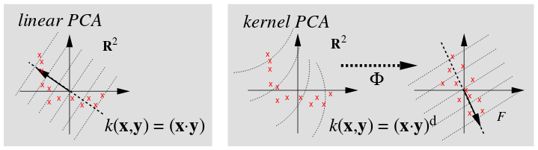
Kernel Principal Component Analysis (kPCA)
Another form of dimension reduction
Similar to Principal Component Analysis
kPCA allows the data to also be described on N-dimensions
kPCA is generalized for a non-linear dimensions
More useful for sorts of pattern analysis
Data was also reduced to two dimensions.

Slide 12
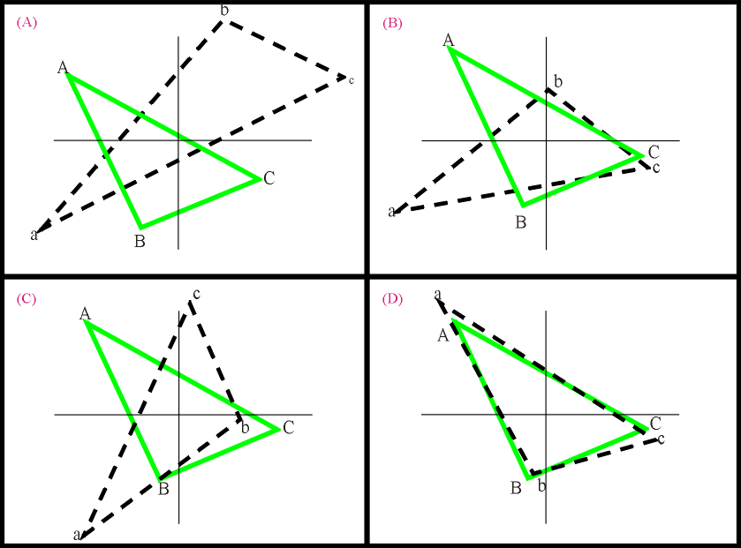
Procrustes Analysis
Takes 2 matrices and finds an optimal transformation of one of them to make them both the same/similar
Minimizing the sum of squares error between matrices
In our case, the reduced 2-dimension MDS/kPCA vs real longitude and latitude of locations.
Rotation, Scaling, Translation
University of Toronto Jackson Labs

Slide 13
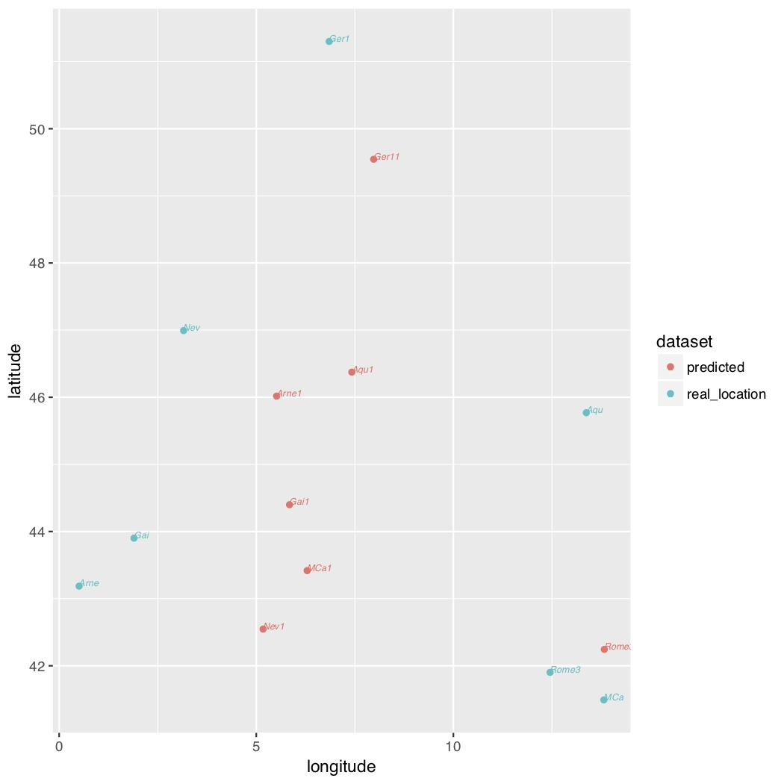
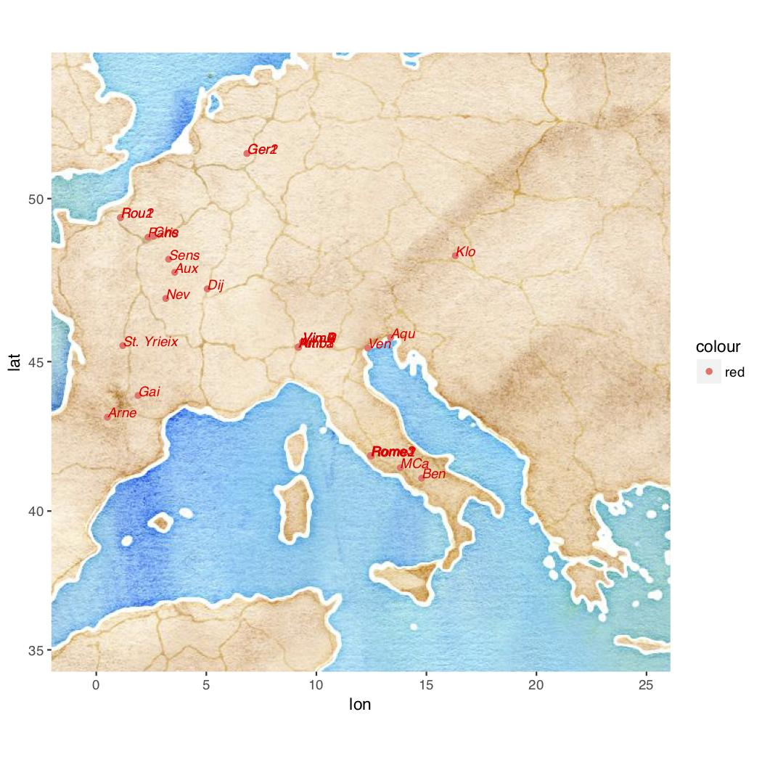
Results
Canberra Distance

Slide 14
Conclusion
Did not work as well as we have liked
May have been because we did not have enough data
May have been the transcribing method
Maybe there’s another distance metric out there we haven’t tried

Slide 15
Acknowledgements
Thank you to:
Dennis Sun
Faculty of Statistics Department
Cal Poly

